Slide 1
Why Your Privacy Matters
Brad Kelso & Steve Kerler,
Co-Founders & Managing Partners

Slide 2
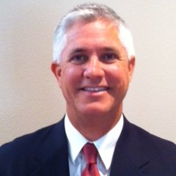


Who Are We?
Privageo is Data Privacy solutions firm:
Addressing the full scope of the Privacy ecosystem
Executing meaningful solutions for our clients
    (versus strategy binders that sit on a shelf)
Delivering Data Privacy consulting and solutions
    A repeatable set of Privacy IP for consultants and clients
Founders of PrivacyOC Community in SOCAL
  Building an online education and networking community
  Sponsor and organizer of in-person conferences
Brad Kelso
Co-Founder & Managing Partner
Steve Kerler
Co-Founder & Managing Partner

Slide 3
TOPICS
What Privacy means to YOU
  Why YOU should care!
How Your Data Has Been “Borrowed”, Stolen, Used and Sold
  Why YOU should care!
The LEGAL Response
  Highlights from the new California Privacy Rights Act (CPRA)
The Consumer & Business Response
  The responses from consumers and companies

Slide 4
What Privacy Means to YOU
… and why YOU should care!

Slide 5
Freedom!
PRIVACY is:
A Human Right
A Personal Choice
Notes:
PRIVACY = FREEDOM
Losing privacy causes, shame, embarrassment
Monitored Behavior Changes Behavior and suppresses freedom of EXPRESSION, ASSOCIATION & ASSEMBLY
Privacy is a fundamental right … essential to democracy
Panopticon - 18th Century Philosopher Jeremy Bentham – building a tower in the center of prison inmates used as method to control behavior
Used by totalitarian rulers as a way to control people
N. Korea, Stalin - Russia, Hitler - Nazi Germany
Chinese professor who discovered COVID
Oppression drives
Conformity, obedience & compliance
enforce conformity , stifle creativity & expression, suppress free speech
Freedom drives
Creativity, open expression of thoughts & Exploration
freedom of EXPRESSION, ASSOCIATION & ASSEMBLY
Why Europe has adopted GDPR (with Germany being the strictest)
It’s rooted in their culture … and in their Laws
PRIVACY = HUMAN RIGHT - Innate to our human spirit
Myth: I Have Nothing to Hide
Assumes you are either a “good person” or a “bad person with secrets to hide
We all have something to hide
Might decide not to go to a political or religious meeting … might be held against us.
If you tell me it’s not, then send me a file with all of your logins and passwords!
Even those who say privacy doesn’t matter, take huge steps to secure their privacy.
Example of Zuckerburg, “Privacy is no longer a social norm.” Yet he and his wife purchased their own house and 4 adjacent ones for $30 million to create a “zone of privacy.”
Arguing that you don’t care about the right to privacy because you have nothing to hide is no different than saying you don’t care about free speech because you have nothing to say.
– Edward Snowden
PRIVACY = PERSONAL CHOICE
I have a secret … do you??
We ALL have things we’d like to keep private and We CHOOSE what they are
Singing in shower … or in public?
Lock door to bathroom … or keep it open?
Bust a move … or sit in the corner
Nude beach … or never see me in a swimsuit?
Share my salary … or none of your business
Share my photos … or not?
Share my political or religious views … or keep the private
Internet / AI has greatly reduced your right to control how your data is used
You sold your data … and you can’t buy it back!
Personal choice needs to be respected!

Slide 6
How Your Data Has Been
“Borrowed”, Used, Stolen and Sold!

Slide 7
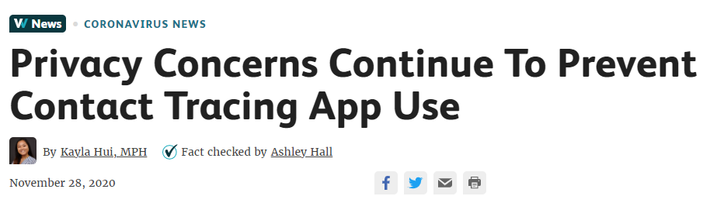
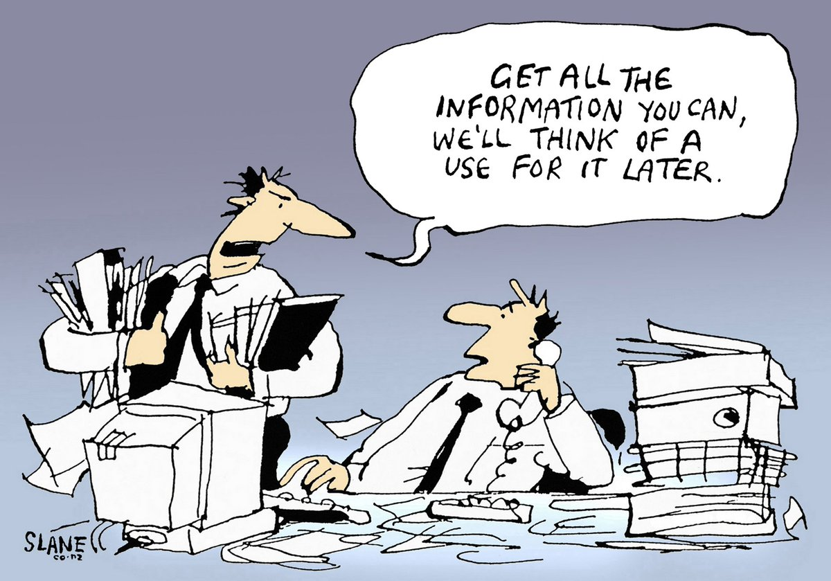
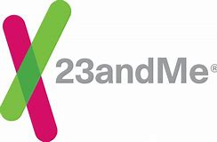

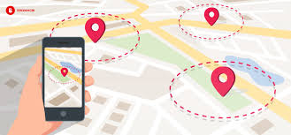
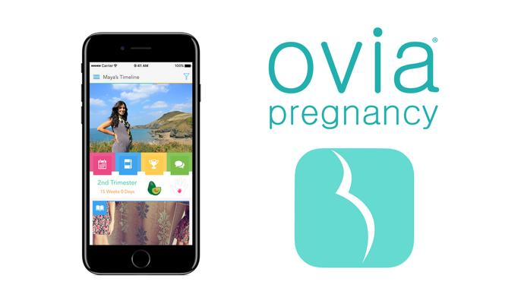



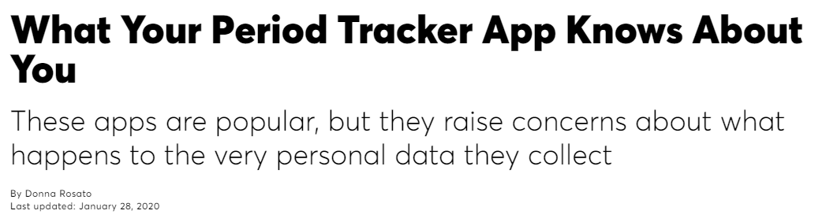




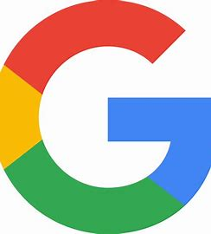


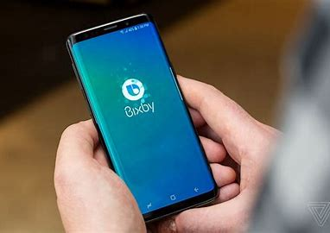


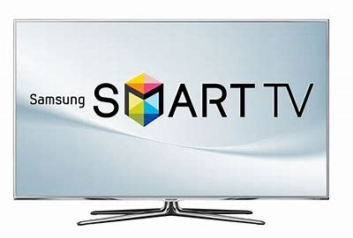
How Your Data Been “Borrowed”!
Services
Healthcare
GEOFENCING
Products
Platforms
Notes:
Video - Hot & Fast Pizza

Slide 8
How Your Data Is Being USED!

Slide 9
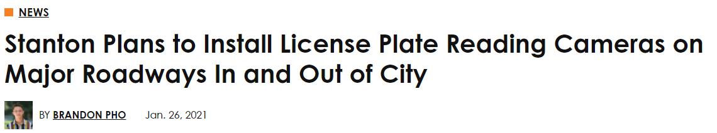
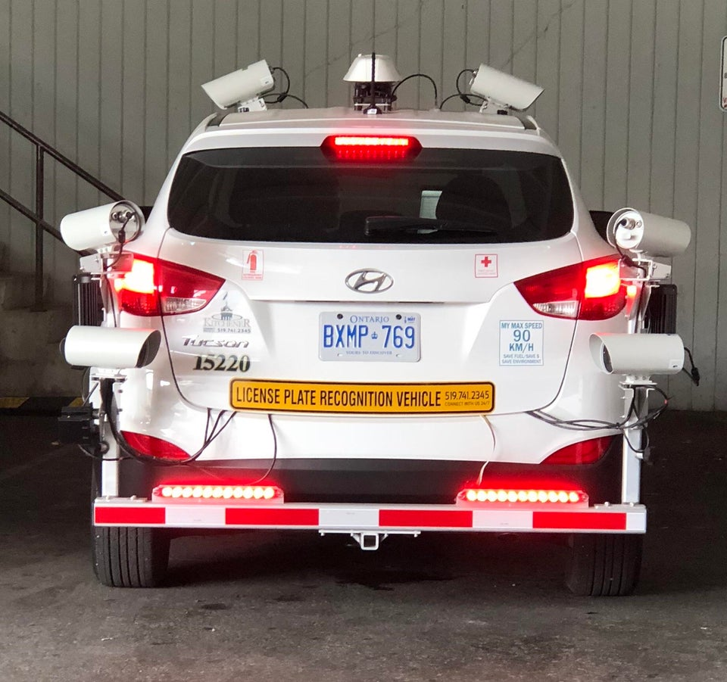
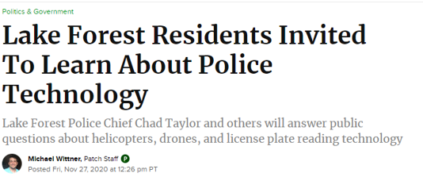
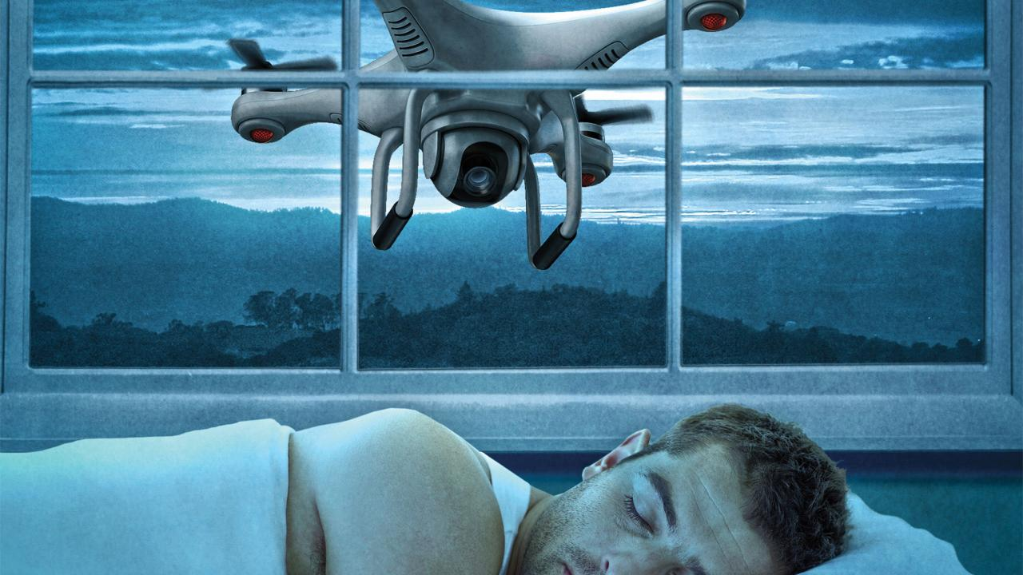

In Your NEIGHBORHOOD
License Plate Scanning
License Plate Scanning
Drones

Slide 10
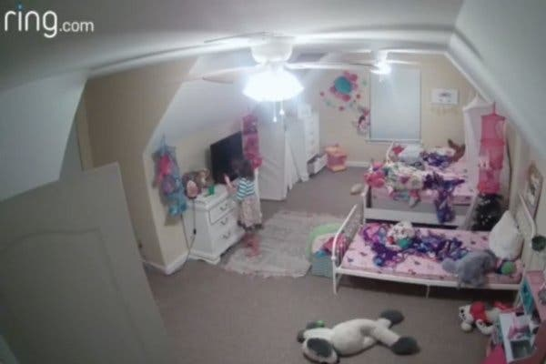
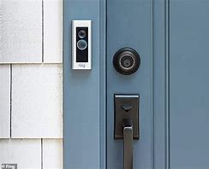
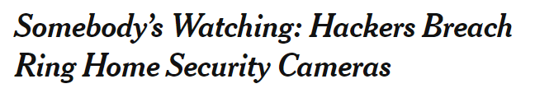
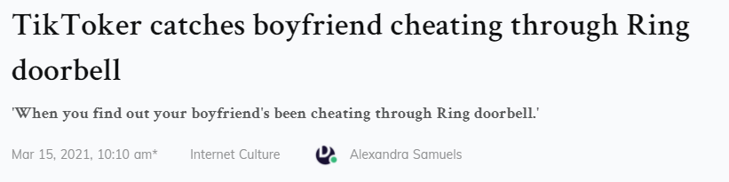
In Your HOME
Ring Doorbells - Privacy vs. Safety
LAPD Requested Ring Footage of Black Lives Matter Protests
BY MATTHEW GUARIGLIA AND DAVE MAASS
FEBRUARY 16, 2021

Slide 11
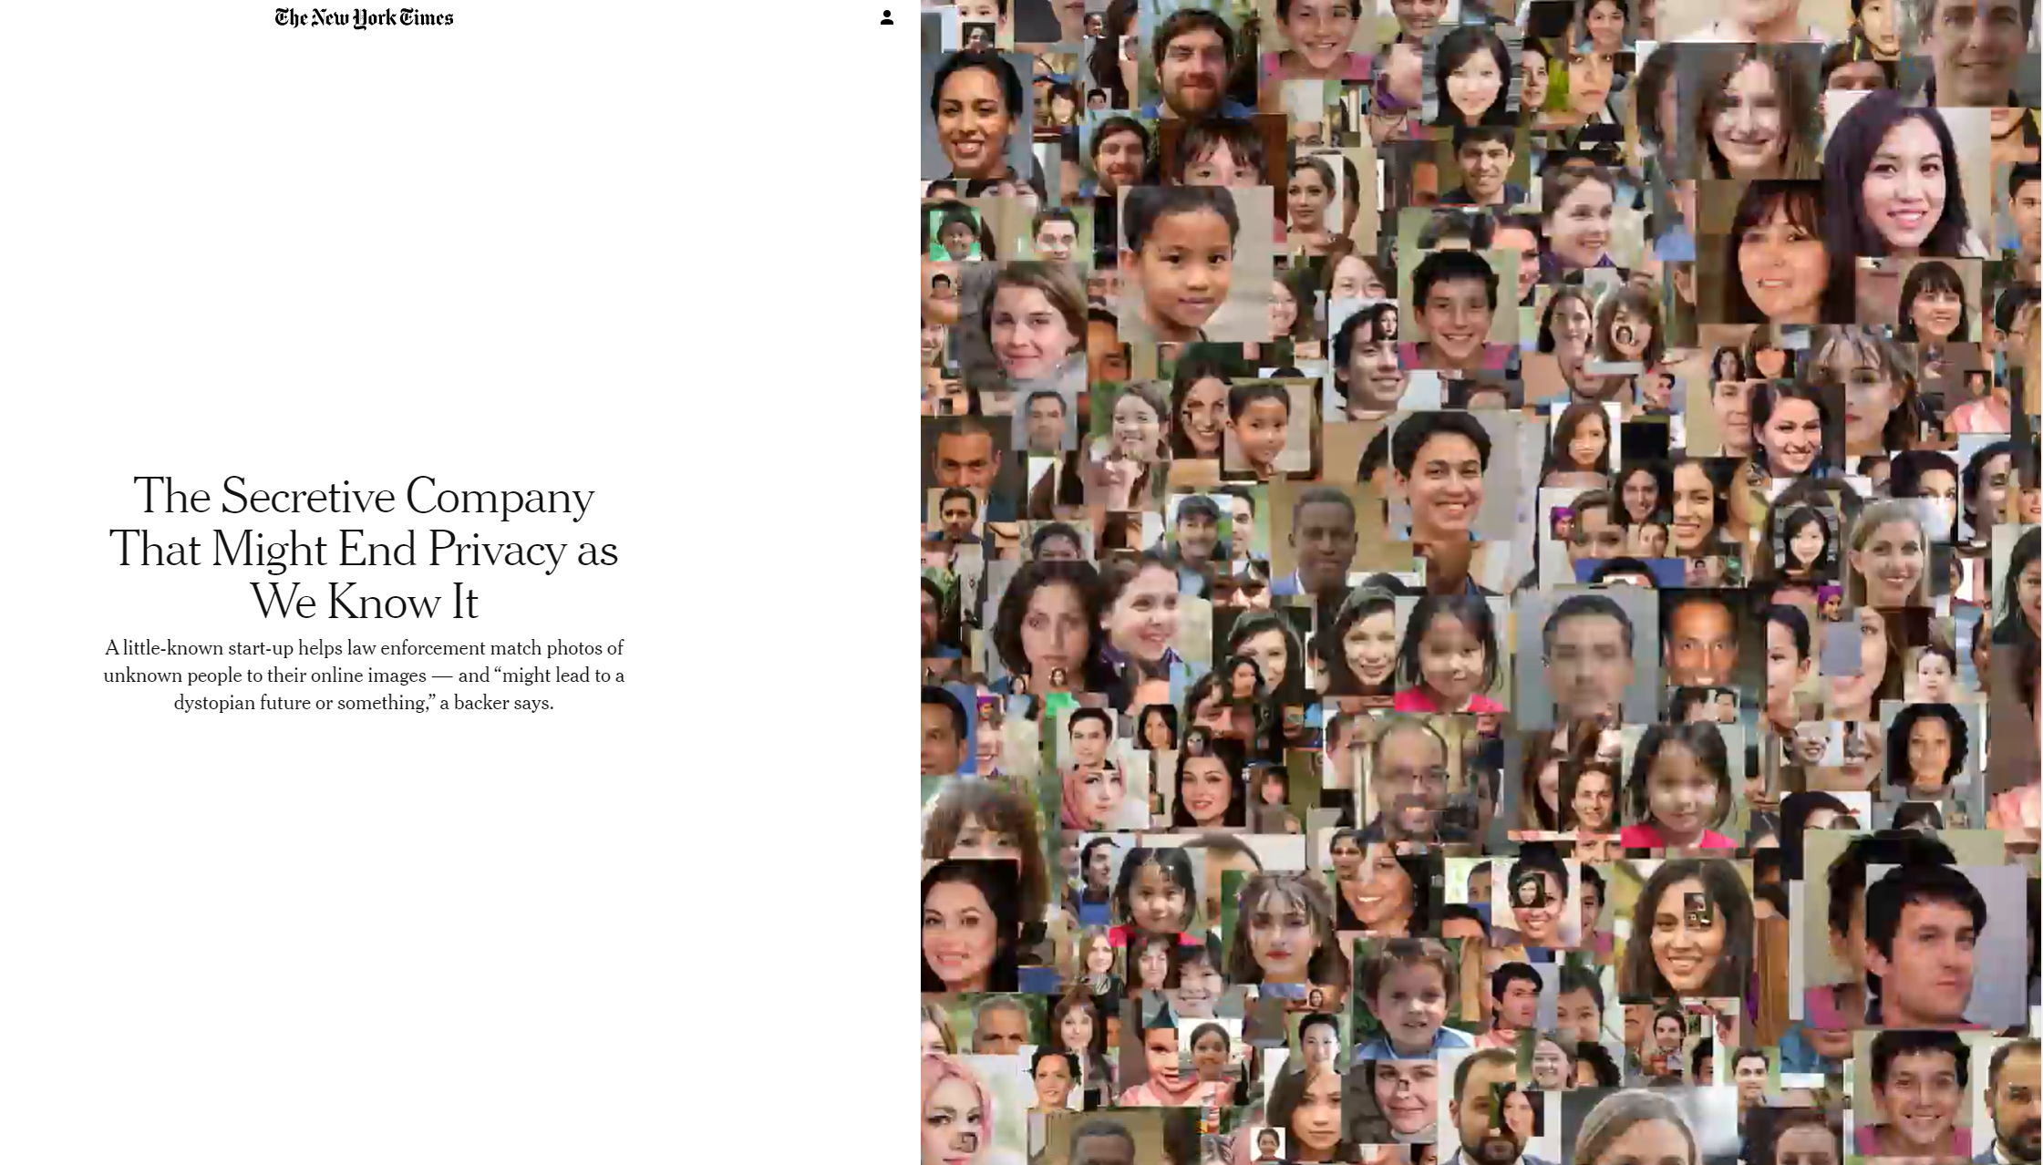
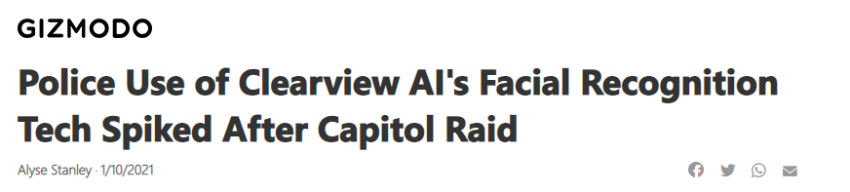
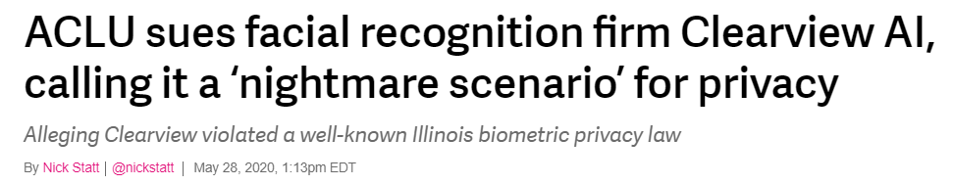
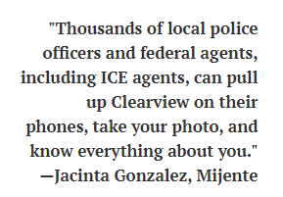
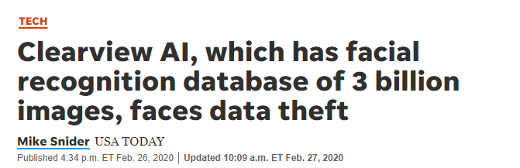
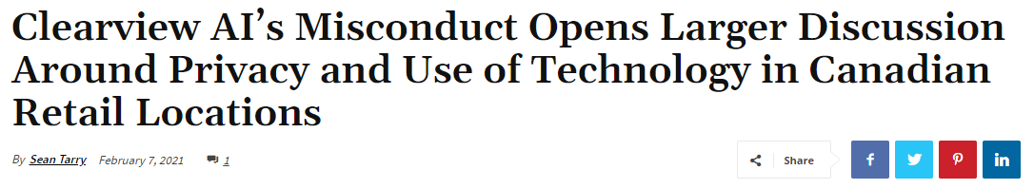
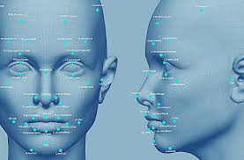
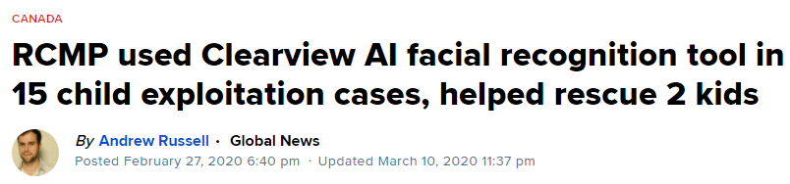
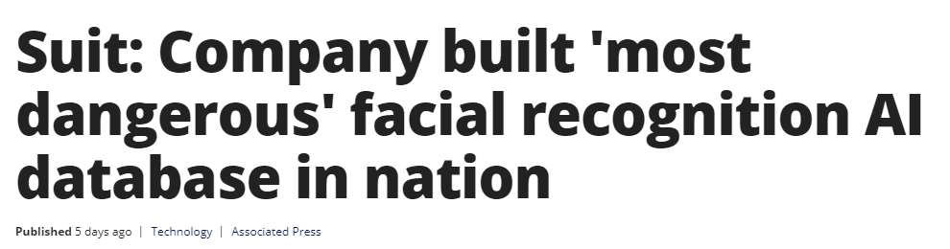
Using Your FACIAL IMAGE
Facial Recognition Technologies:
Clearview AI Case
Facial Recognition
Notes:
Video – The Great Hack trailer

Slide 12
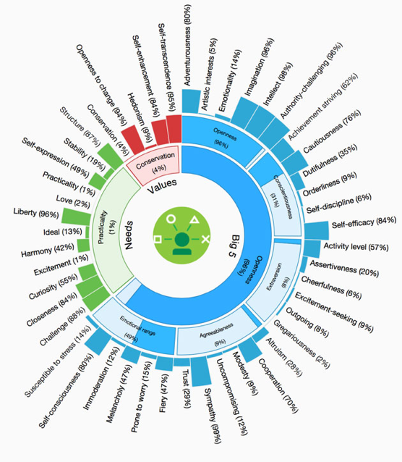


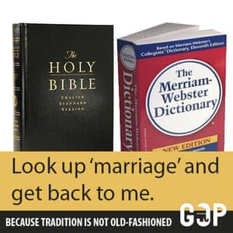
Using Your PERSONALITY!
Artificial Intelligence & the
Cambridge Analytica Case
87 million Facebook users
5000 data points on each American voter!
Personality quiz to determine personality profiles
  Results from user’s friends captured also
RESULT? $5 Billion penalty!
  What Facebook makes in about 3 months!
Sample Ad:
Someone who is “Conscientious” ” may get this compelling ad
Dictionary and Bible is a source of order and a conscientious person is deferential to order.
IBM Watson personality prediction

Slide 13
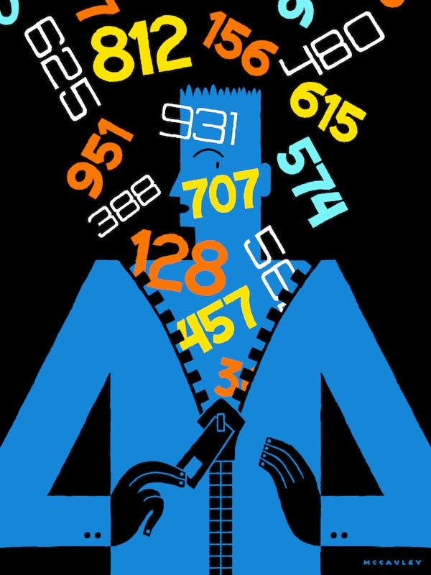
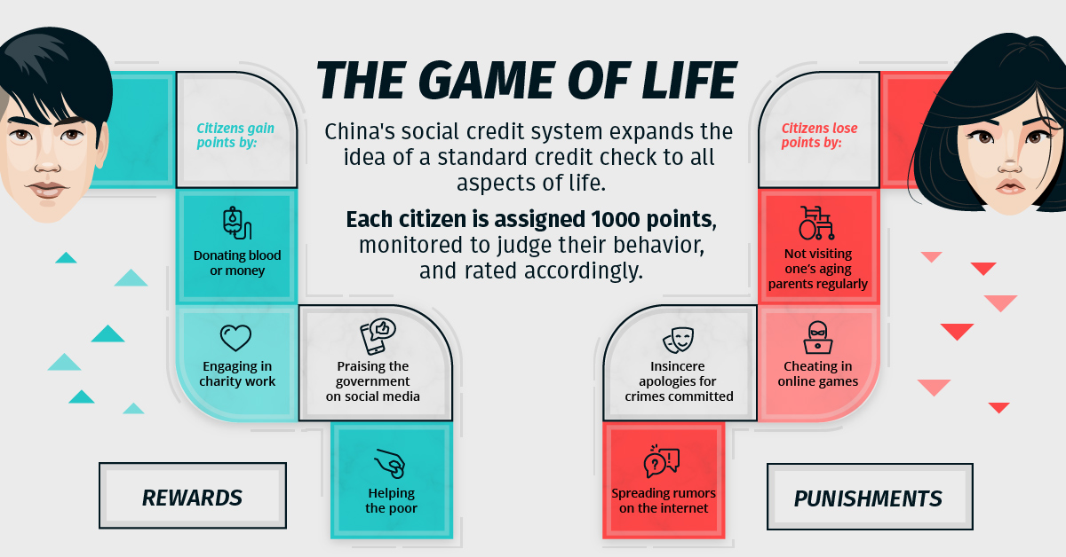
Defining YOU!
Now ‘Who’ Are You?
Old YOU - Entrenched Scores:
  “Fair Isaac” plus each of 3 bureaus
  “Income” (now+/-15% accuracy)
  “Psychographics” (propensity to buy)
  “Lifestyles” 66 per Experian
  “Rank” GPAs, SAT’s, Class, DMV, BBB
  Chinese? Social Credit Score
New YOU - New subjective
  Sift: “Can you be trusted? (Airbnb, OK Cupid)
  Zeta: Do you have $ to spend? (BMW)
  Retailer Equation: Will you return purchases?
  My Life: Personal Reputation? (employment, dating)
  OCEAN: How ‘persuadable’ are you? (Politics)
  Riskified: How ‘crooked’ are you? (fraud)

Slide 14
Are “You” for Sale?
Yes, your data is being bought and sold by nefarious actors in the dark web.
Credit Cards
Payment Processing accounts
Social Media Hacks
Forged Documents
User Names / Passwords
Email Databases
Malware on Endpoints

Slide 15
The LEGAL Response

Slide 16

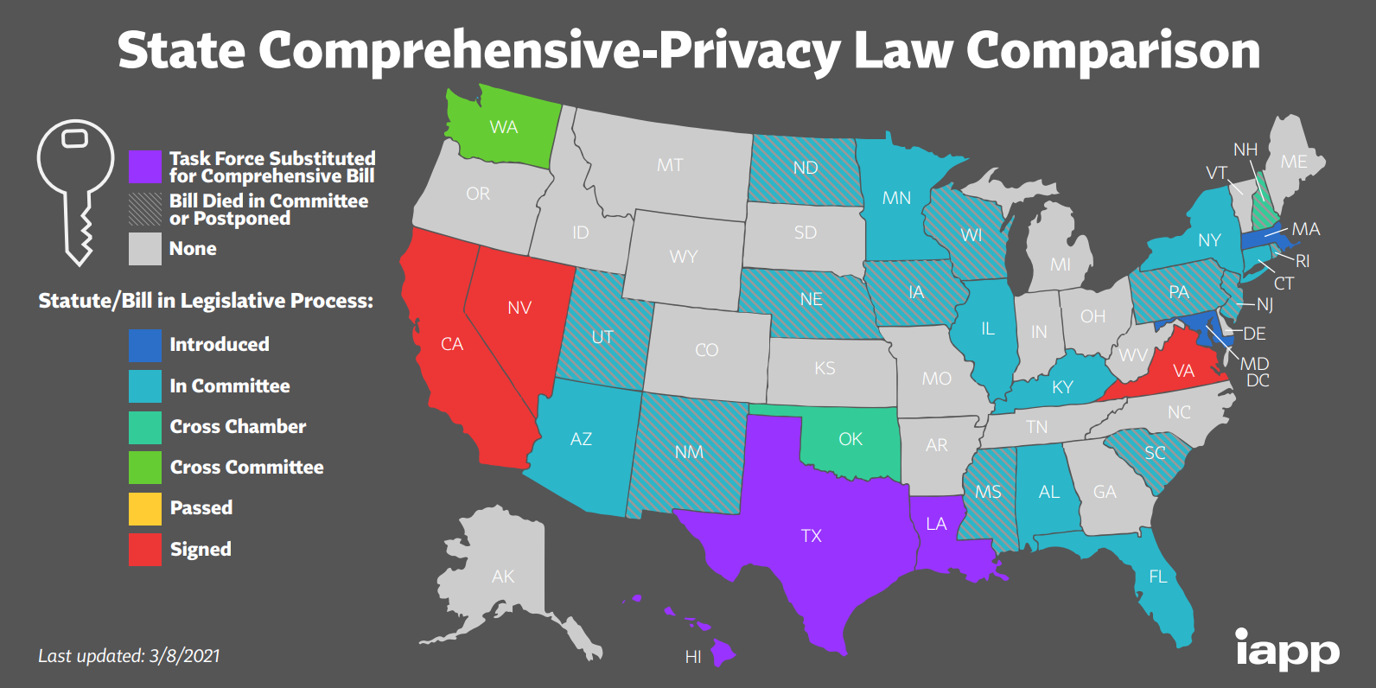
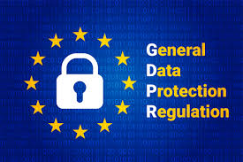







The LEGAL Response
In the U.S.
(by sector or state)
Globally!
(by country)
Europe (GDPR)
Brazil
Privacy Shield
Canada
… and others
… and More!
South Africa

Slide 17

New Consumer Rights
To Know what personal data the business has collected about them
To Delete & Correct their personal data used by the business
To Disclosure of their personal data in a “portable format”
To Opt-out of the SALE of their data
To Seek Damages
To Equal Service (consumer can’t be offered different pricing, quality, features, etc.)
New Funded Enforcement Agency
Begins July 1st 2021
With $10 million in annual funding!

Slide 18
The Consumer & Business
Response
Notes:
Tim Cooke – Apple video

Slide 19
Consumers’ Attitudes toward Privacy
  The Data Trade?
    “81% say the potential risks from data collection by companies outweighs the benefits and yet they don’t believe it’s possible to go through daily life without companies collecting data on them (Pew Research Center)
    46% feel they’ve lost control over their own data (Salesforce)
  Churn?
    48% have stopped buying from a company over privacy concerns (Tableau)
    39% would likely walk away if asked to provide highly personal data (akamai)
    53% would get their information back if afforded the option (PwC)
  Trust?
    64% blame the company - not the hacker - for a loss of personal data (RSA)
    45% say the federal government should be responsible for protecting data privacy (Cisco)
    88% say their willingness to share personal information is based on how much they trust a company (PwC)
Consumers Stop Buying from Companies they Don’t Trust!

Slide 20
The Business Response
  Emerging Businesses & Technologies
    Privacy Browsers & Search Engines (e.g. Brave, DuckDuck Go, TOR)
    Cookie-less browsers
    Platforms that allow consumers to “sell” or “Trade” their personal data
    Privacy and Security compliance platforms
    Data Analytics for classification
    Data encryption & protection (e.g., blockchain)
    Privacy by Design
Business are Prioritizing Security & Privacy
Protecting Privacy = Good Business!

